Slide 1
Installing Solar Panels at Gallaudet University
By: David, Elina, Larry, Mbisana, and Dylan
Notes:
Pitch your project to the class using data, facts, and/or examples illustrating:
(i) Background to understand the project;
(ii) the main question or problem;
(iii) objective and specific aims;
(iv) approaches, methods, tools/techniques;
(v) significance/potential impact on GU or others.

Slide 2
Background
Implementing solar panels on Gallaudet University campus is an effective and easy way to introduce clean energy with proven technology. Solar panels offer both an environmental and economic benefits. Especially at university where energy consumption is high.
The solar panel is renewables source of energy.
Gallaudet is committed to the goal of District of Columbia to become the “Greenest College Town in America. Gallaudet agrees to “Supply 20% of campus energy from renewable sources by 2020 and 50% by 2030.” and “Purchase or generate at least 13 percent of total energy consumed from renewable sources.” [2]
One part of meeting Gallaudet’s sustainability pledge is to explore the use of solar panels. Solar panel installation on the Gallaudet campus to see how it benefits to Gallaudet University and the community.
Our research finds why solar panels are an excellent idea for universities to save their money by having solar panels on the campus.
Notes:
(i) Background to understand the project;
* Why not say something about how Gallaudet is almost ready to sign a contract with Community Solar to generate electricity for the neighborhood? Check out Community Solar.

Slide 3
Question
Question: Which location is the best to pilot the solar panels to inform the university about the potential of solar as an energy source as they prepare to sign the contract?
Notes:
(ii) the main question or problem;

Slide 4
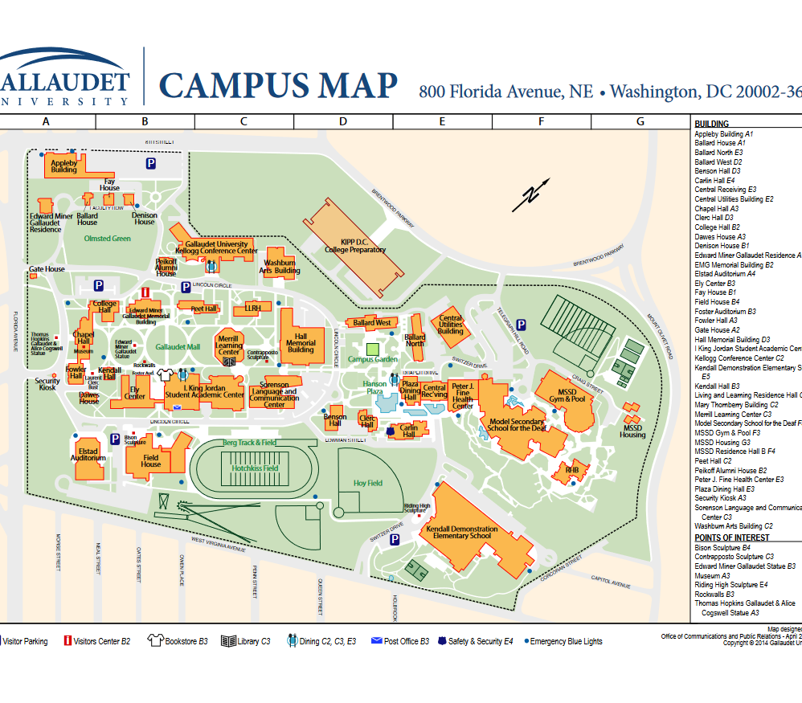
Objective
Our goal is to find the best location for solar panel installation on the Gallaudet campus to provide electricity from solar energy.
Since Gallaudet University's goal and process with solar panels, we want to help by be part of a pilot study for them by study in one location.
https://www.gallaudet.edu/documents/Human-Resources/campus-map.pdf
Notes:
(iii) objective and specific aims;

Slide 5
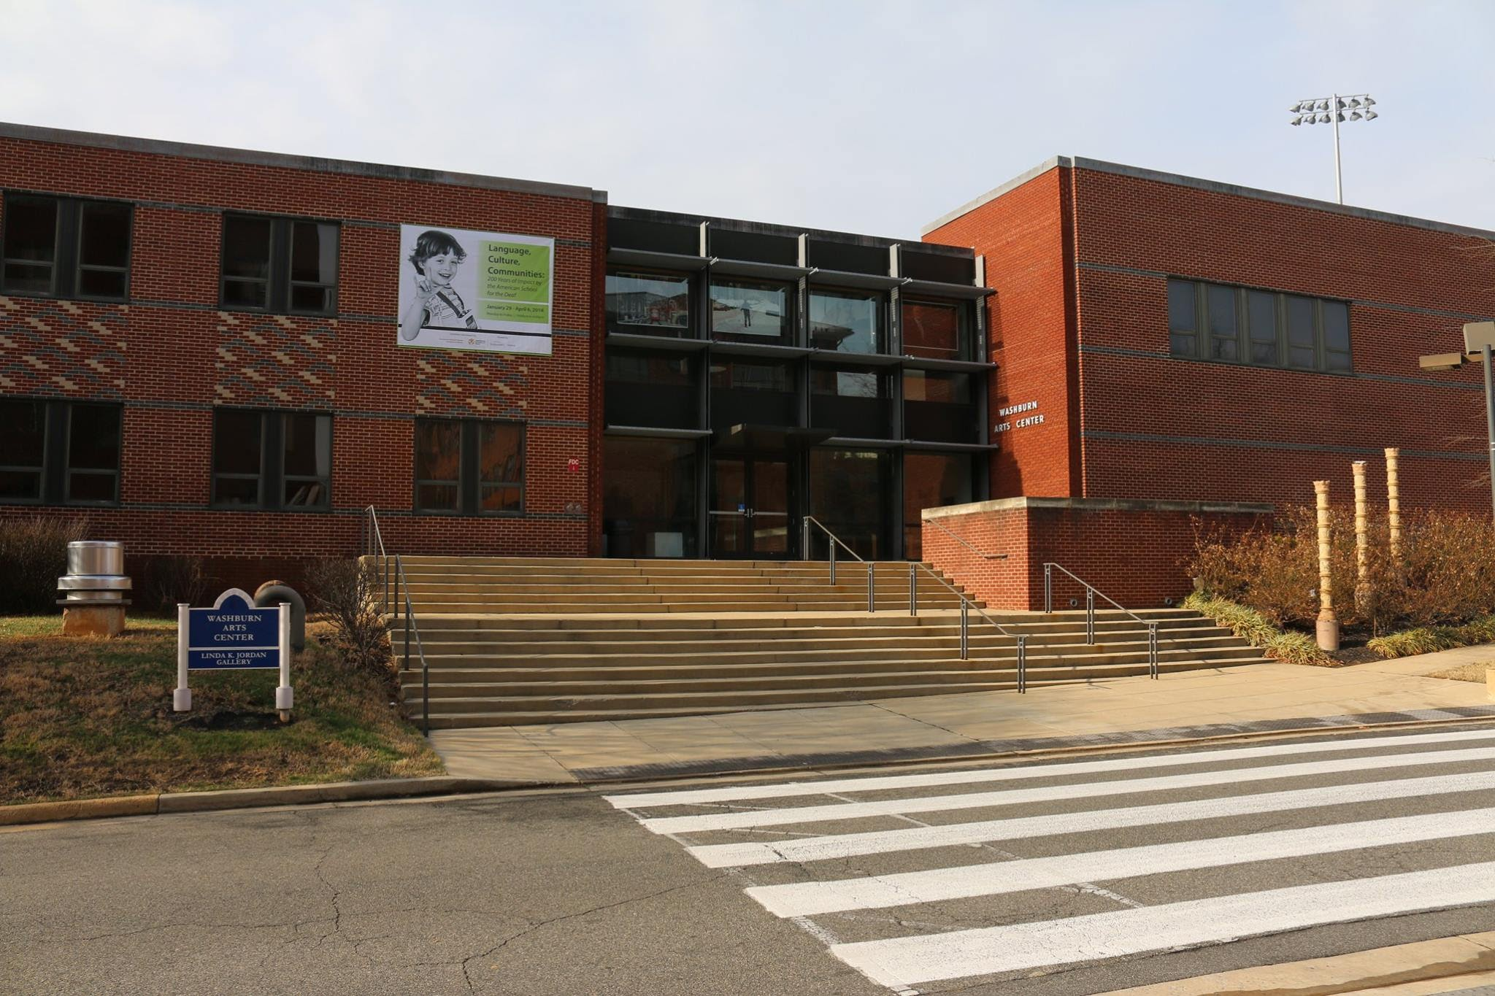
Washburn Arts Building Location Set-up Goal

Slide 6
Method
Find a location on the Gallaudet campus, then solar panel installation to get solar energy and collect data.
Over this project, our team used the process of elimination, and with David Good’s help, we determined the best location for a solar system on Gallaudet University property will be Washburn Art Building (WAB)
Once we get supplies (solar panels & data collector) then we will collect the data at WAB rooftop
We will display the data by this website
Global solar Atlas show the data from website link: https://globalsolaratlas.info/detail?c=38.906618,-76.993439,11&s=38.906618,-76.993439&m=site&pv=hydro,180,10,1000
Notes:
(iv) approaches, methods, tools/techniques;

Slide 7
How potentially impact on GU?
Gallaudet is thinking about installing solar panels for the campus to provide energy to the nearby neighborhood.
If we can collect data and show the benefits of having a solar system on our campus, that also benefits the community.
A quick, easy and ethical way to go green and to make a money. Solar panels systems will save Gallaudet University money in long term and return on investment.
Our planet is constantly receiving energy from the sun, so why not utilize it?
The average solar installation in Washington, DC that it is range costs from $ 14,000 to $19,000. Link: https://www.energysage.com/local-data/solar-panel-cost/dc/
Notes:
(v) significance/potential impact on GU or others.

Slide 8
References
Campus map 800 Florida Avenue, NE Washington, DC 20002-3695 - Gallaudet University. (n.d.). Retrieved October 18, 2021, from https://www.gallaudet.edu/documents/Human-Resources/campus-map.pdf.
Commitments. Gallaudet University. (2021, January 12). Retrieved October 18, 2021, from https://www.gallaudet.edu/sustainability/commitments.
District of columbia mayors college and University Sustainability pledge. Gallaudet University. (2021, January 12). Retrieved October 18, 2021, from https://www.gallaudet.edu/sustainability/commitments/district-of-columbia-mayors-college-and-university-sustainability-pledge.
Energysage. EnergySage. (n.d.). Retrieved October 18, 2021, from https://www.energysage.com/local-data/solar-panel-cost/dc/.
Solargis. (n.d.). Global solar atlas. Retrieved October 18, 2021, from https://globalsolaratlas.info/detail?c=38.906618%2C-76.993439%2C11&s=38.906618%2C-76.993439&m=site&pv=hydro%2C180%2C10%2C1000.
Notes:
Change to APA

